Slide 1

Use Of Jigsaw Puzzle Solving Algorithms In The Real World

Slide 2
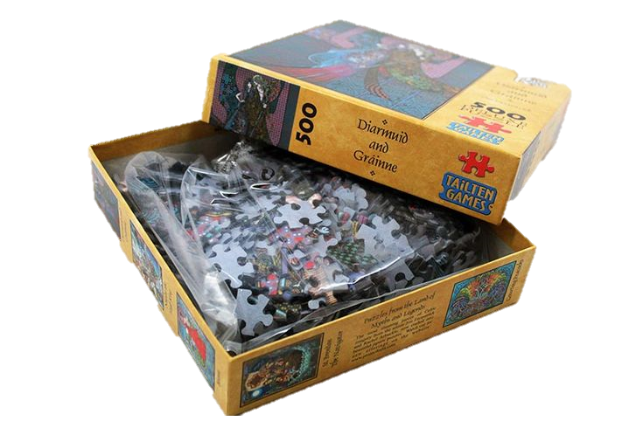
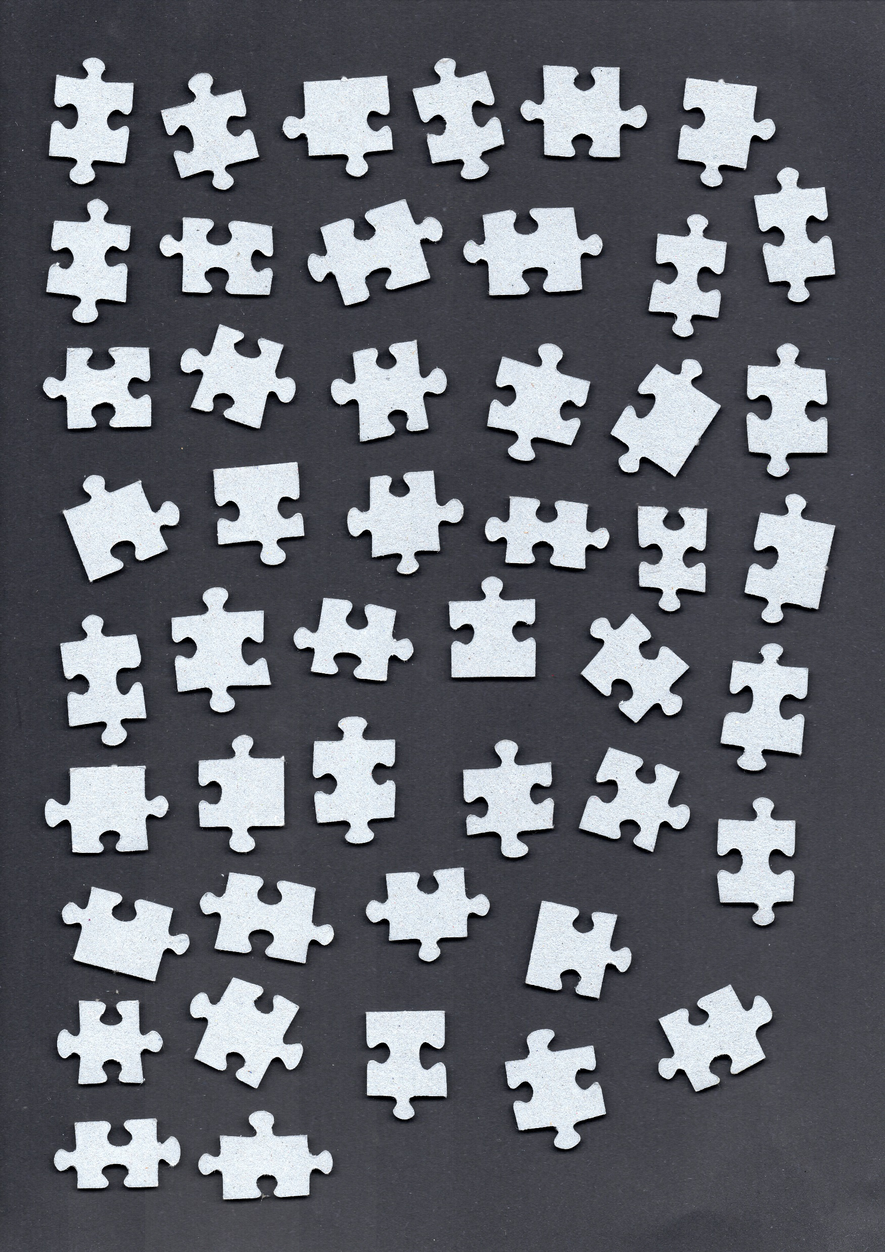

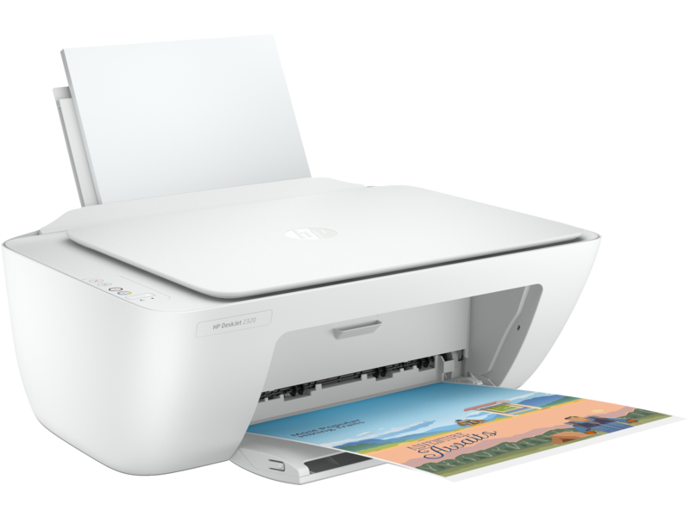

The Process
Solving Algorithm
Scanner
Physical Puzzle
Image of a Puzzle
Puzzle Solution

Slide 3
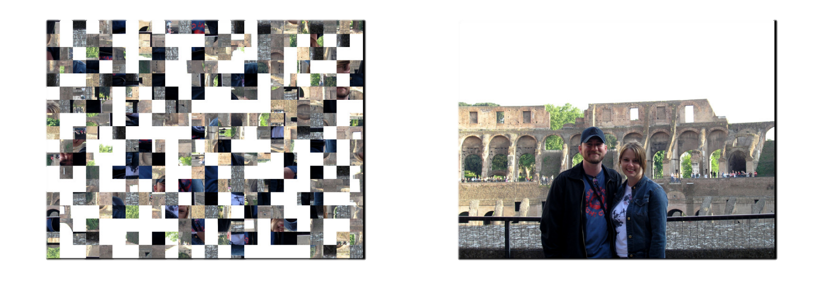

Two Kind of Jigsaw Puzzles
Real World Puzzles
Digital Puzzles

Slide 4

Same but Different
Inaccurate Representation
Pixel Perfect Representation

Slide 5

The Objectives
 What is the difference in execution time between digital and real-world puzzles?
What are the challenges to use the current state of the art algorithms developed for digital puzzles in the real-world, and how can we overcome them?

Slide 6

Algorithm Structure
Splitter
Comparator
Solver

Slide 7

The Splitter

Slide 8
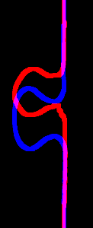

The Comparator
$$Score =\frac{Area (P1∩P2)}{Area (P1∪P2)} \\ Score ∈ ℝ \\ 0≤Score≤1$$

Slide 9
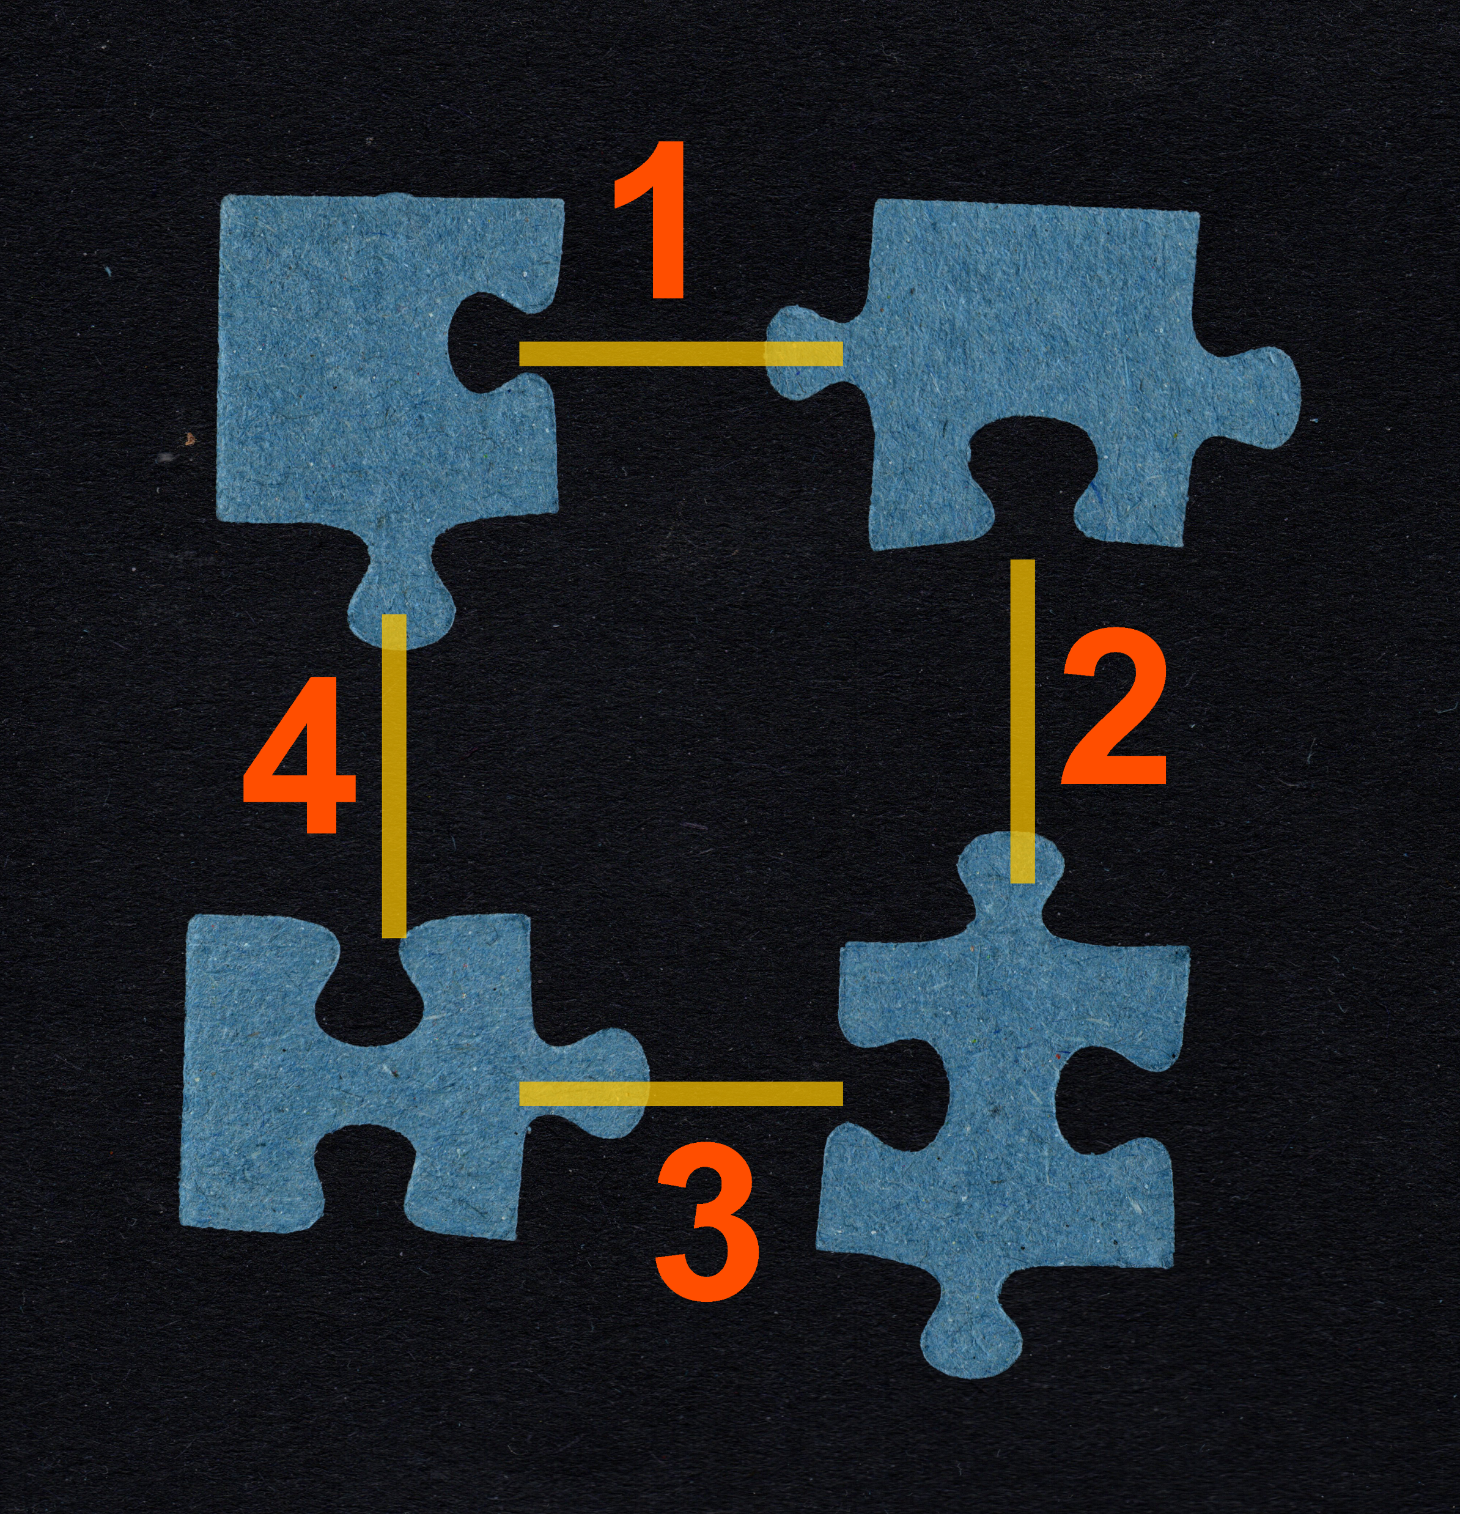
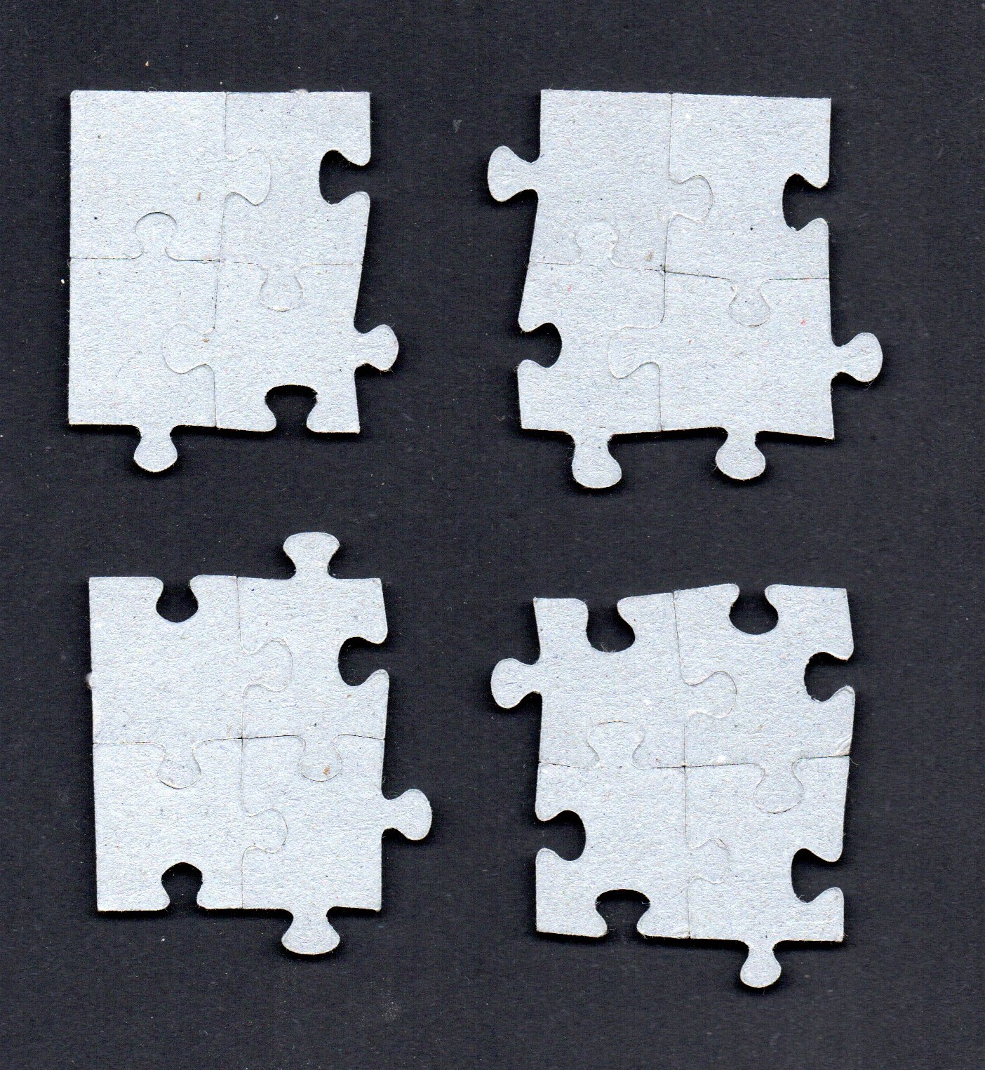
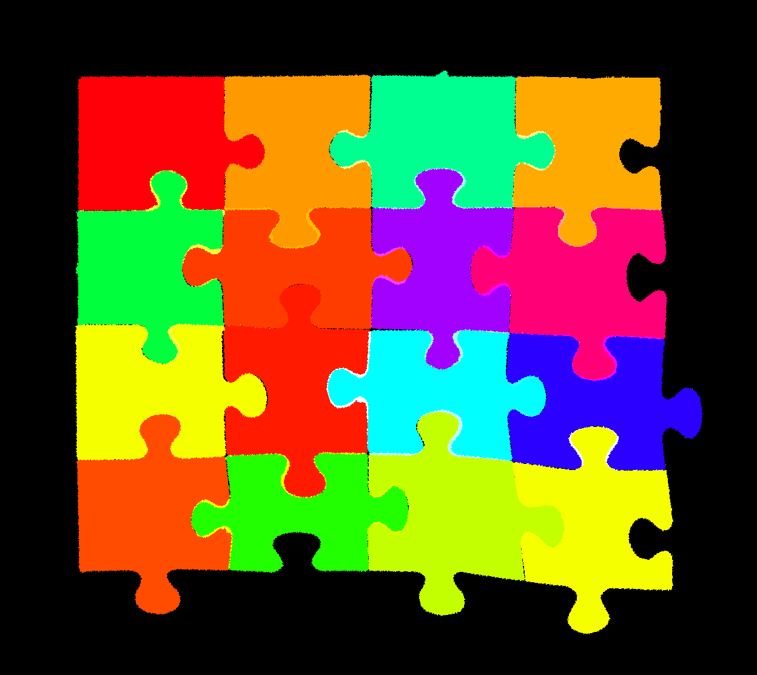
The Solver

Slide 10

Evaluation

Slide 11
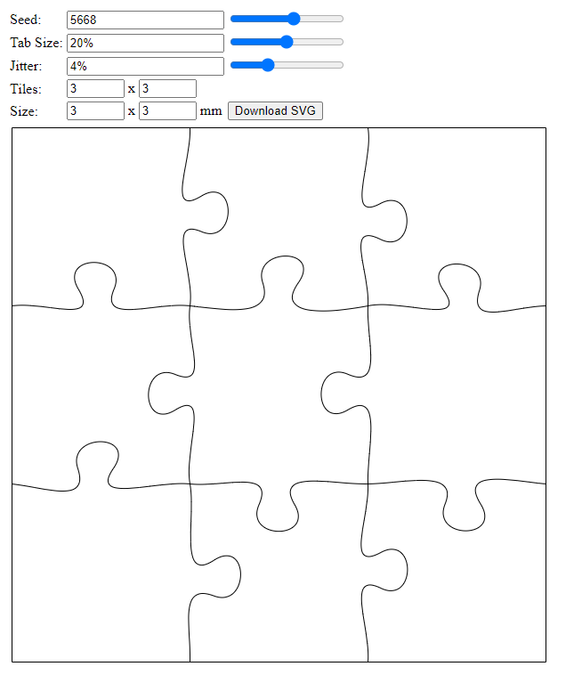
A digital puzzle to solve
https://puzzle.telegnom.org/

Slide 12
Execution Time vs Puzzle Size
Size | Pieces | Execution time [s]
 |  | Digital puzzle | Real Puzzle
2x3 | 6 | 1 | 4
3x4 | 12 | 3 | 14
4x4 | 16 | 4 | 59
4x5 | 20 | 4 | 48
5x8 | 40 | 20 | 627
8x8 | 64 | 30 | 2851
8x12 | 96 | 660 | N/A
16x16 | 256 | 377 | N/A

Slide 13
Execution Time Consistency
Run to run vairance on a 4x4 real puzzle
Execution time [s] | Avrege | Standard deviation
64 | 47.8 | 18.6
68
43
24
29
59

Slide 14
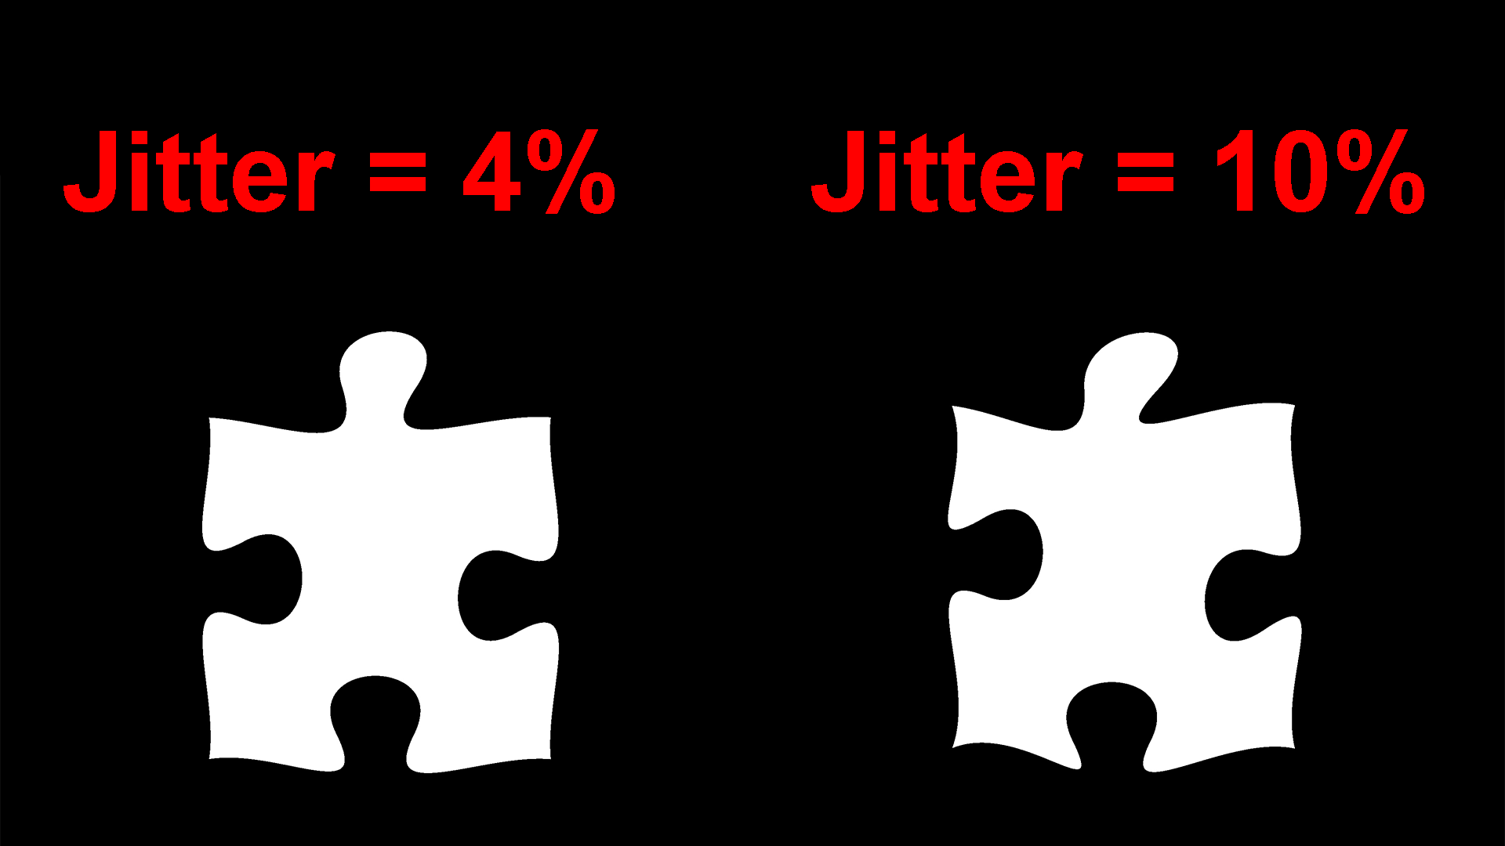
Execution Time vs Jitter
Jitter effect on an 8x8 digital puzzle
Jitter | Execution time [s]
4% | 104
5% | 30
6% | 17
8% | 17
10% | 16

Slide 15
Accuracy
Manually evaluated accuracy of the solution
Puzzle size | Puzzle kind | Accuracy
4x4 | real world | 100%
8x8 | real world | 100%
16x16 | digital | 100%

Slide 16

Conclusions

Slide 17
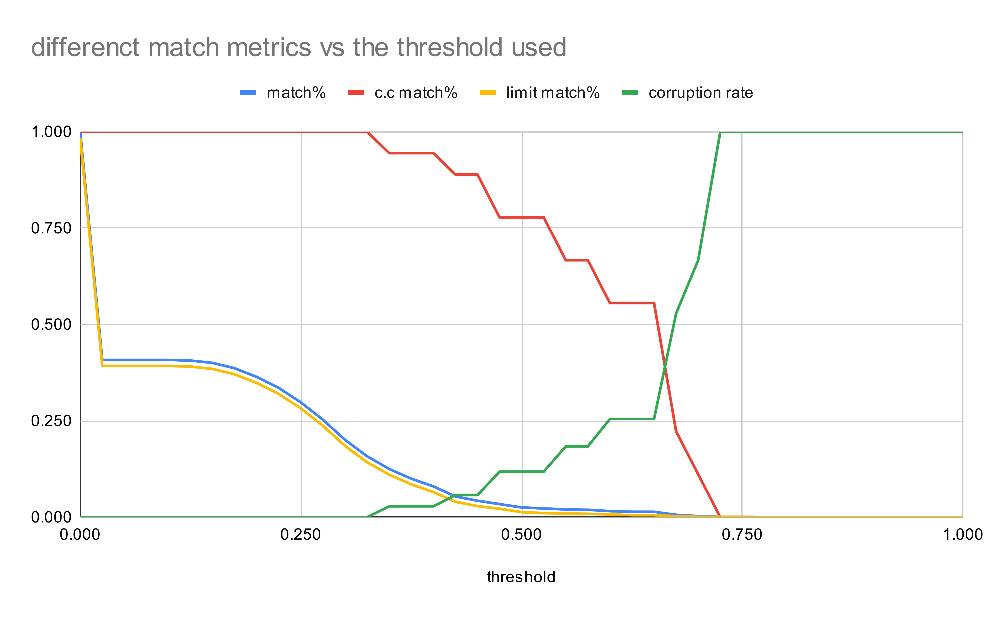
Applying current State of the Art Algorithm to the Real World

Slide 18
Improving the Comparator
Traditional computer vision
Pro:
Can be developed relatively fast, without the need of a dataset
Cons:
Hard to achieve high accuracy
Machine Learning
Pro:
Good for achieving high accuracy even with imperfect data
Cons:
Need a dataset that could require hundred of hours to collect

Slide 19
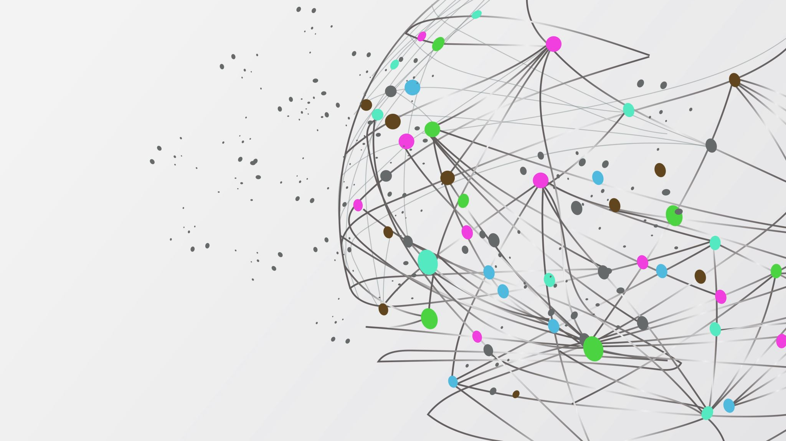
Labeling Tool

Slide 20

Thanks for your attention

Slide 21

Questions?

